Slide 1

Istio

Slide 2
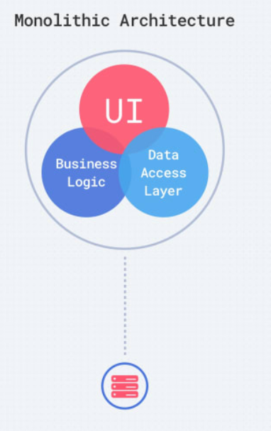
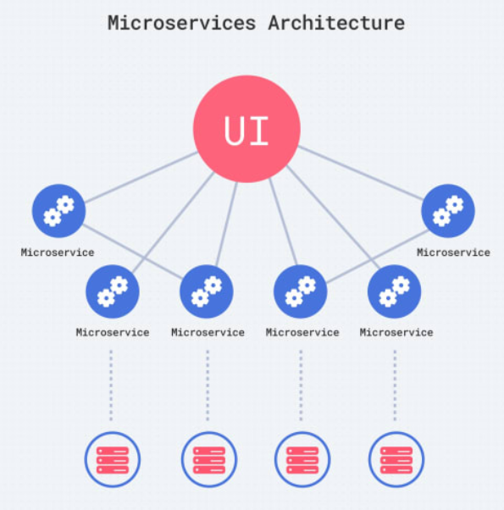

Monolith v/s Microservices

Slide 3

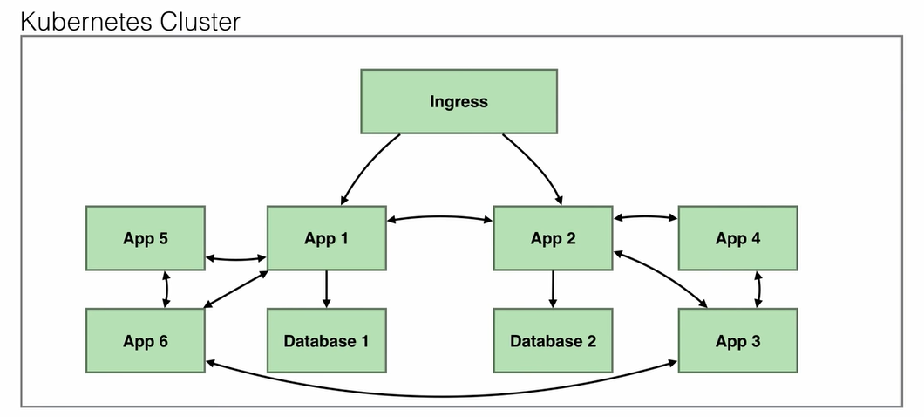
Kubernetes Cluster
Encryption
Retries, Failover
Load balancing
Routing decisions
Metrics/Logs/Traces
Access Control

Slide 4
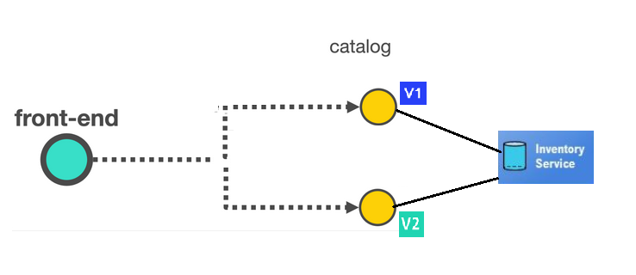
Problem statement?
Dynamically configure how the services are connected.
Secure workload by mutual TLS between services
Observe how my application is performing end to end
Control who has access to talk to what

Slide 5
What is Service Mesh
Provide a transparent and language independent way to easily automate application network functions
Infrastructure layer for handling service-to-service communication.
Network infrastructure for your microservices
Notes:
The data plane is composed of a set of intelligent proxies (Envoy) deployed as sidecars. These proxies mediate and control all network communication between microservices along with Mixer, a general-purpose policy and telemetry hub.
The control plane manages and configures the proxies to route traffic. Additionally, the control plane configures Mixers to enforce policies and collect telemetry.

Slide 6
What is Istio
An opensource platform to automate service interactions across containers and VM based workloads
Connect - Intelligent traffic routing and flow
Secure - Managed Authentication and Encryption
Control - Enforce policy driven communication across services
Observe - Automatic tracing Monitoring and Logging

Slide 7
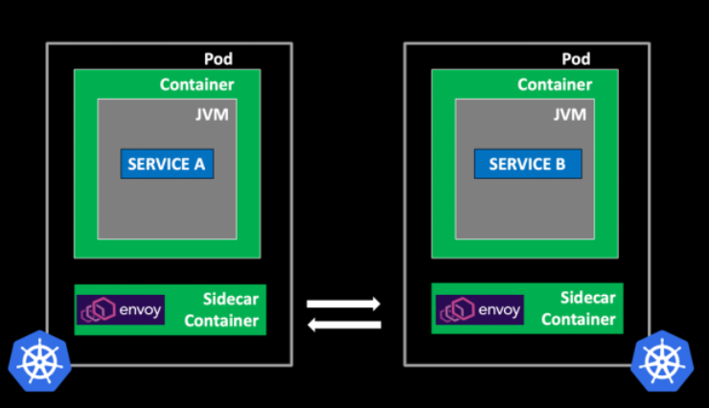
How Istio works
Sidecar proxies (Envoy) injected to your PODs
Proxy mediates all inbound/outbound traffic
Notes:
The data plane is composed of a set of intelligent proxies (Envoy) deployed as sidecars.
Primary Responsibilities of the Sidecar Proxy: Service Discovery, Load Balancing, Authentication and Authorization, Request Tracing, Traffic Management, Fault Injection, Rate Limiting, Observability

Slide 8
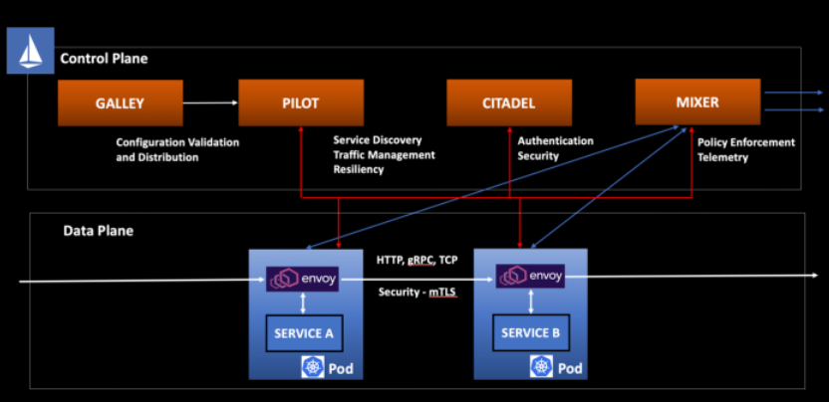
How Istio works
Istio Control plane is deployed in Kubernetes
Istio API is installed as CRDs in Kubernetes
We don’t directly interact with sidecar proxies. It is done through control plane component (Pilot)

Slide 9
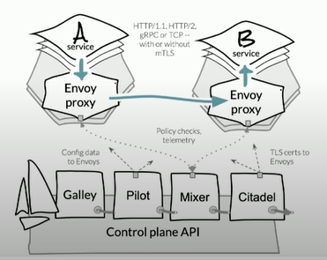
How Istio works ?
Pilot - Control Plane to configure and push service communication policies
Envoy - Network proxy to intercept communication and apply policies
Mixer - Policy enforcement
Citadel - Service to service Auth using Mutual TLS
Galley - Configuration validation, distribution

Slide 10
Benefits - Traffic Management
Basic visibility on interaction between services. Which services which one ?
Dynamically configure how services are connected to each other
Canary Deployments
Retry Policy, Circuit Breaking to harden the system

Slide 11
Secure communication
Policies on which service can communicate to which other
Mutual TLS between services
Encryption in transit

Slide 12
Control Access
Control who has access to what ..
How can one service access other ? For Exp:- Http, gRPC
More granular control like http GET, POST allowed between calls

Slide 13
Observability
How my services are doing end to end ?
See where the bottlenecks are in the system
How traffic is flowing ?

Slide 14
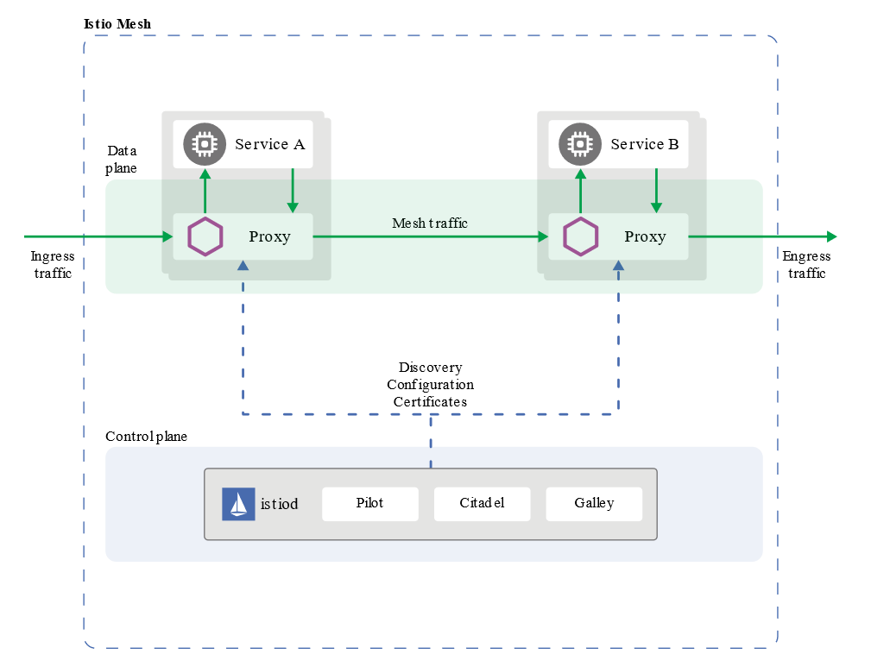
Architecture

Slide 15
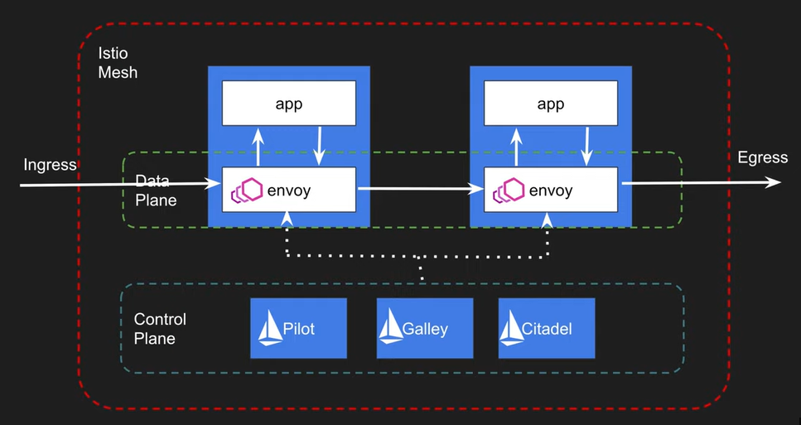
Istio
Notes:
Keep your application business focused and dynamically program the intelligence to the network.
Envoy Proxy -
Envoy is a high-performance proxy developed in C++ to mediate all inbound and outbound traffic for all services in the service mesh.
Envoy proxies are deployed as sidecars to services. Because it intercepts all incoming and outgoing calls, it gets to know lots of signals in terms of traffic behaviour as attributes.
It can use them to make policy decisions, and send them to monitoring systems.
Also it can do traffic control by enforcing fine grained control on http/2, gRPC etc.
Retry, Failover, Circuit breaker etc
Enforce security policies
Pilot - provides service discovery for the Envoy sidecars, traffic management capabilities for intelligent routing and resiliency (timeouts, retries, circuit breakers, etc.).
Pilot converts high level routing rules that control traffic behavior into Envoy-specific configurations, and propagates them to the sidecars at runtime.
Citadel
strong service-to-service and end-user authentication with built-in identity and credential management.
Using Citadel, operators can enforce policies based on service identity rather than on relatively unstable layer 3 or layer 4 network identifiers.
Galley - Receive the yaml (CRDs defined) and validates it and hand over to Piot and Piolet will convert it to Envoy configuration
Gateways - Is like Loadbalancer that sits at the edges of the mesh. Intercepts incoming and outgoing http services
Virtual services - To direct the traffic from gateway to services.. It could be bound to a gateway, or it could be bound to a service and direct traffic to other services.
Destination Rules - Apply rules like TLS, Circuit breaking etc

Slide 16
How do we tell Istio to configure side car proxy ?
Istio Traffic API
Gateway
Destination Rule
Virtual Service
Service Entry
Notes:
Keep your application business focused and dynamically program the intelligence to the network.
Envoy Proxy -
Envoy is a high-performance proxy developed in C++ to mediate all inbound and outbound traffic for all services in the service mesh.
Envoy proxies are deployed as sidecars to services. Because it intercepts all incoming and outgoing calls, it gets to know lots of signals in terms of traffic behaviour as attributes.
It can use them to make policy decisions, and send them to monitoring systems.
Also it can do traffic control by enforcing fine grained control on http/2, gRPC etc.
Retry, Failover, Circuit breaker etc
Enforce security policies
Pilot - provides service discovery for the Envoy sidecars, traffic management capabilities for intelligent routing and resiliency (timeouts, retries, circuit breakers, etc.).
Pilot converts high level routing rules that control traffic behavior into Envoy-specific configurations, and propagates them to the sidecars at runtime.
Citadel
strong service-to-service and end-user authentication with built-in identity and credential management.
Using Citadel, operators can enforce policies based on service identity rather than on relatively unstable layer 3 or layer 4 network identifiers.
Galley - Receive the yaml (CRDs defined) and validates it and hand over to Piot and Piolet will convert it to Envoy configuration
Gateways - Is like Loadbalancer that sits at the edges of the mesh. Intercepts incoming and outgoing http services
Virtual services - To direct the traffic from gateway to services.. It could be bound to a gateway, or it could be bound to a service and direct traffic to other services.
Destination Rules - Apply rules like TLS, Circuit breaking etc

Slide 17
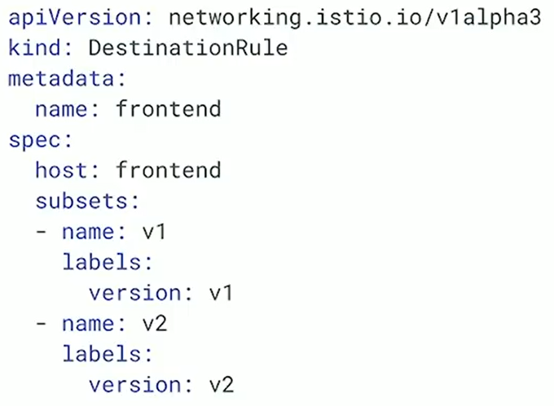
Destination Rule
A way to group service into subsets
Partition a service into multiple versions
Configure what happens to traffic for that destination
Notes:
Keep your application business focused and dynamically program the intelligence to the network.
Envoy Proxy -
Envoy is a high-performance proxy developed in C++ to mediate all inbound and outbound traffic for all services in the service mesh.
Envoy proxies are deployed as sidecars to services. Because it intercepts all incoming and outgoing calls, it gets to know lots of signals in terms of traffic behaviour as attributes.
It can use them to make policy decisions, and send them to monitoring systems.
Also it can do traffic control by enforcing fine grained control on http/2, gRPC etc.
Retry, Failover, Circuit breaker etc
Enforce security policies
Pilot - provides service discovery for the Envoy sidecars, traffic management capabilities for intelligent routing and resiliency (timeouts, retries, circuit breakers, etc.).
Pilot converts high level routing rules that control traffic behavior into Envoy-specific configurations, and propagates them to the sidecars at runtime.
Citadel
strong service-to-service and end-user authentication with built-in identity and credential management.
Using Citadel, operators can enforce policies based on service identity rather than on relatively unstable layer 3 or layer 4 network identifiers.
Galley - Receive the yaml (CRDs defined) and validates it and hand over to Piot and Piolet will convert it to Envoy configuration
Gateways - Is like Loadbalancer that sits at the edges of the mesh. Intercepts incoming and outgoing http services
Virtual services - To direct the traffic from gateway to services.. It could be bound to a gateway, or it could be bound to a service and direct traffic to other services.
Destination Rules - Apply rules like TLS, Circuit breaking etc

Slide 18
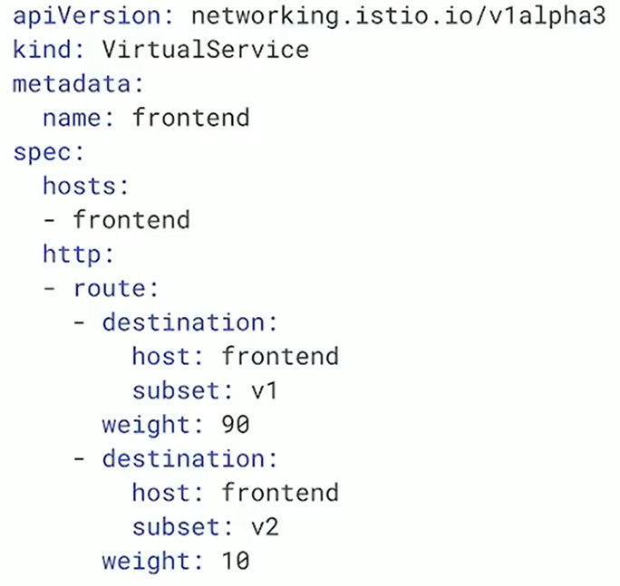
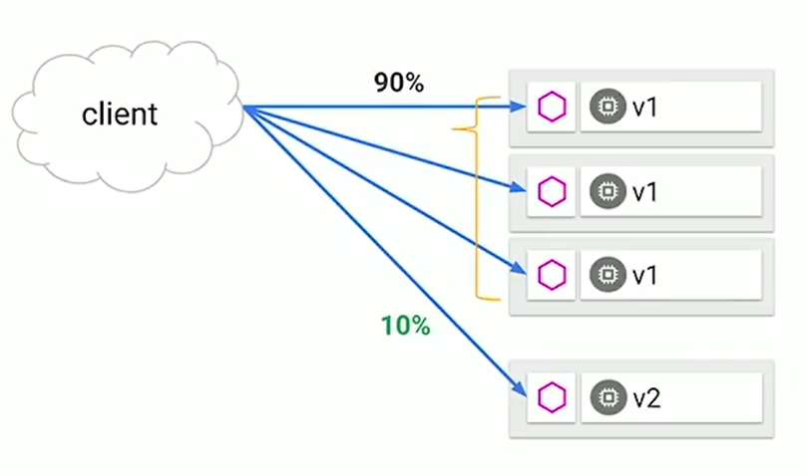
Virtual Service
How you route your traffic to a given destination
Notes:
Keep your application business focused and dynamically program the intelligence to the network.
Envoy Proxy -
Envoy is a high-performance proxy developed in C++ to mediate all inbound and outbound traffic for all services in the service mesh.
Envoy proxies are deployed as sidecars to services. Because it intercepts all incoming and outgoing calls, it gets to know lots of signals in terms of traffic behaviour as attributes.
It can use them to make policy decisions, and send them to monitoring systems.
Also it can do traffic control by enforcing fine grained control on http/2, gRPC etc.
Retry, Failover, Circuit breaker etc
Enforce security policies
Pilot - provides service discovery for the Envoy sidecars, traffic management capabilities for intelligent routing and resiliency (timeouts, retries, circuit breakers, etc.).
Pilot converts high level routing rules that control traffic behavior into Envoy-specific configurations, and propagates them to the sidecars at runtime.
Citadel
strong service-to-service and end-user authentication with built-in identity and credential management.
Using Citadel, operators can enforce policies based on service identity rather than on relatively unstable layer 3 or layer 4 network identifiers.
Galley - Receive the yaml (CRDs defined) and validates it and hand over to Piot and Piolet will convert it to Envoy configuration
Gateways - Is like Loadbalancer that sits at the edges of the mesh. Intercepts incoming and outgoing http services
Virtual services - To direct the traffic from gateway to services.. It could be bound to a gateway, or it could be bound to a service and direct traffic to other services.
Destination Rules - Apply rules like TLS, Circuit breaking etc

Slide 19
Canary deployment
Rules
Notes:
Keep your application business focused and dynamically program the intelligence to the network.
Envoy Proxy -
Envoy is a high-performance proxy developed in C++ to mediate all inbound and outbound traffic for all services in the service mesh.
Envoy proxies are deployed as sidecars to services. Because it intercepts all incoming and outgoing calls, it gets to know lots of signals in terms of traffic behaviour as attributes.
It can use them to make policy decisions, and send them to monitoring systems.
Also it can do traffic control by enforcing fine grained control on http/2, gRPC etc.
Retry, Failover, Circuit breaker etc
Enforce security policies
Pilot - provides service discovery for the Envoy sidecars, traffic management capabilities for intelligent routing and resiliency (timeouts, retries, circuit breakers, etc.).
Pilot converts high level routing rules that control traffic behavior into Envoy-specific configurations, and propagates them to the sidecars at runtime.
Citadel
strong service-to-service and end-user authentication with built-in identity and credential management.
Using Citadel, operators can enforce policies based on service identity rather than on relatively unstable layer 3 or layer 4 network identifiers.
Galley - Receive the yaml (CRDs defined) and validates it and hand over to Piot and Piolet will convert it to Envoy configuration
Gateways - Is like Loadbalancer that sits at the edges of the mesh. Intercepts incoming and outgoing http services
Virtual services - To direct the traffic from gateway to services.. It could be bound to a gateway, or it could be bound to a service and direct traffic to other services.
Destination Rules - Apply rules like TLS, Circuit breaking etc

Slide 20
Autoscaling deployments
apiVersion: networking.istio.io/v1alpha3
kind: VirtualService
metadata:
name: helloworld
spec:
hosts:
- helloworld
http:
- route:
- destination:
host: helloworld
subset: v1
weight: 90
- destination:
host: helloworld
subset: v2
weight: 10
---
apiVersion: networking.istio.io/v1alpha3
kind: DestinationRule
metadata:
name: helloworld
spec:
host: helloworld
subsets:
- name: v1
labels:
version: v1
- name: v2
labels:
version: v2
$ kubectl autoscale deployment helloworld-v1 --cpu-percent=50 --min=1 --max=10
deployment "helloworld-v1" autoscaled
$ kubectl autoscale deployment helloworld-v1 --cpu-percent=50 --min=1 --max=10
deployment "helloworld-v1" autoscaled
Notes:
Keep your application business focused and dynamically program the intelligence to the network.
Envoy Proxy -
Envoy is a high-performance proxy developed in C++ to mediate all inbound and outbound traffic for all services in the service mesh.
Envoy proxies are deployed as sidecars to services. Because it intercepts all incoming and outgoing calls, it gets to know lots of signals in terms of traffic behaviour as attributes.
It can use them to make policy decisions, and send them to monitoring systems.
Also it can do traffic control by enforcing fine grained control on http/2, gRPC etc.
Retry, Failover, Circuit breaker etc
Enforce security policies
Pilot - provides service discovery for the Envoy sidecars, traffic management capabilities for intelligent routing and resiliency (timeouts, retries, circuit breakers, etc.).
Pilot converts high level routing rules that control traffic behavior into Envoy-specific configurations, and propagates them to the sidecars at runtime.
Citadel
strong service-to-service and end-user authentication with built-in identity and credential management.
Using Citadel, operators can enforce policies based on service identity rather than on relatively unstable layer 3 or layer 4 network identifiers.
Galley - Receive the yaml (CRDs defined) and validates it and hand over to Piot and Piolet will convert it to Envoy configuration
Gateways - Is like Loadbalancer that sits at the edges of the mesh. Intercepts incoming and outgoing http services
Virtual services - To direct the traffic from gateway to services.. It could be bound to a gateway, or it could be bound to a service and direct traffic to other services.
Destination Rules - Apply rules like TLS, Circuit breaking etc

Slide 21
Autoscaling deployments
$ kubectl get pods | grep helloworld
helloworld-v1-3523621687-3q5wh 0/2 Pending 0 15m
helloworld-v1-3523621687-73642 2/2 Running 0 11m
helloworld-v1-3523621687-7hs31 2/2 Running 0 19m
helloworld-v1-3523621687-dt7n7 2/2 Running 0 50m
helloworld-v1-3523621687-gdhq9 2/2 Running 0 11m
helloworld-v1-3523621687-jxs4t 0/2 Pending 0 15m
helloworld-v1-3523621687-l8rjn 2/2 Running 0 19m
helloworld-v1-3523621687-wwddw 2/2 Running 0 15m
helloworld-v1-3523621687-xlt26 0/2 Pending 0 19m
helloworld-v2-4095161145-963wt 2/2 Running 0 50m
apiVersion: networking.istio.io/v1alpha3
kind: VirtualService
metadata:
name: helloworld
spec:
hosts:
- helloworld
http:
- route:
- destination:
host: helloworld
subset: v1
weight: 90
- destination:
host: helloworld
subset: v2
weight: 10
---
apiVersion: networking.istio.io/v1alpha3
kind: DestinationRule
metadata:
name: helloworld
spec:
host: helloworld
subsets:
- name: v1
labels:
version: v1
- name: v2
labels:
version: v2
Notes:
Keep your application business focused and dynamically program the intelligence to the network.
Envoy Proxy -
Envoy is a high-performance proxy developed in C++ to mediate all inbound and outbound traffic for all services in the service mesh.
Envoy proxies are deployed as sidecars to services. Because it intercepts all incoming and outgoing calls, it gets to know lots of signals in terms of traffic behaviour as attributes.
It can use them to make policy decisions, and send them to monitoring systems.
Also it can do traffic control by enforcing fine grained control on http/2, gRPC etc.
Retry, Failover, Circuit breaker etc
Enforce security policies
Pilot - provides service discovery for the Envoy sidecars, traffic management capabilities for intelligent routing and resiliency (timeouts, retries, circuit breakers, etc.).
Pilot converts high level routing rules that control traffic behavior into Envoy-specific configurations, and propagates them to the sidecars at runtime.
Citadel
strong service-to-service and end-user authentication with built-in identity and credential management.
Using Citadel, operators can enforce policies based on service identity rather than on relatively unstable layer 3 or layer 4 network identifiers.
Galley - Receive the yaml (CRDs defined) and validates it and hand over to Piot and Piolet will convert it to Envoy configuration
Gateways - Is like Loadbalancer that sits at the edges of the mesh. Intercepts incoming and outgoing http services
Virtual services - To direct the traffic from gateway to services.. It could be bound to a gateway, or it could be bound to a service and direct traffic to other services.
Destination Rules - Apply rules like TLS, Circuit breaking etc

Slide 22
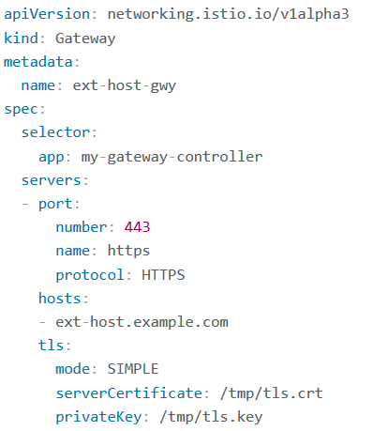
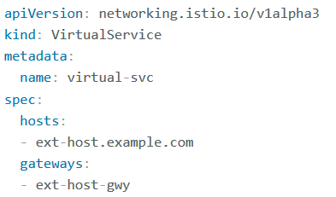
Istio Gateway
Manage inbound and outbound traffic for your mesh letting you specify which traffic you want to enter or leave the mesh.
Allow us to configure layer 4-6 load balancing properties such as ports to expose, TLS settings

Slide 23
How does Istio know the endpoints to invoke the service ?
To populate its own service registry, Istio connects to a service discovery system.
For example, if you’ve installed Istio on a Kubernetes cluster, then Istio automatically detects the services and endpoints in that cluster.

Slide 24
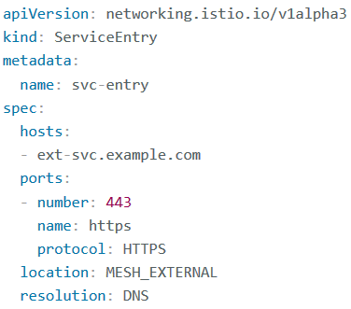
Service Entry
Is to add an entry to the service registry that Istio maintains internally
After you add the service entry, the Envoy proxies can send traffic to the service as if it was a service in your mesh
Redirect and forward traffic for external destinations
Define retry, timeout, and fault injection policies for external destinations.

Slide 25
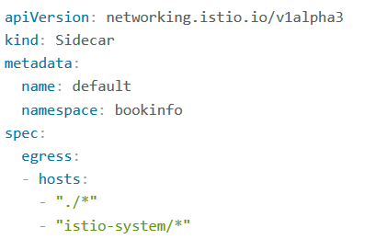
Sidecars
Fine-tune the set of ports and protocols that an Envoy proxy accepts.
Limit the set of services that the Envoy proxy can reach

Slide 26
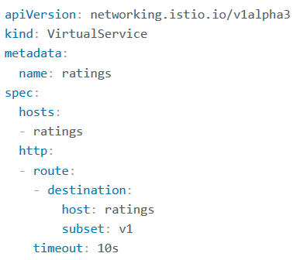
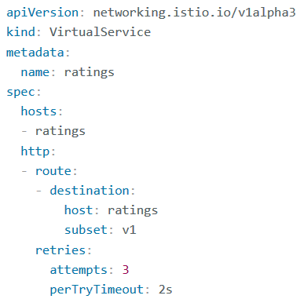
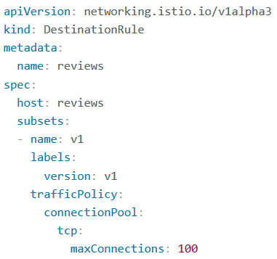
Network Resiliency
Timeout
Retry
Circuit Breaker

Slide 27
Observability
Metrics
Distributed Traces
Access Logs

Slide 28
Istio Egress
How to access external services ?
Allow the Envoy proxy to pass requests through to services that are not configured inside the mesh.
Configure service entries to provide controlled access to external services.
Completely bypass the Envoy proxy for a specific range of IPs

Slide 29
Egress - Envoy passthrough to external services
$ kubectl get configmap istio -n istio-system -o yaml
| grep -o "mode: ALLOW_ANY"
global.outboundTrafficPolicy.mode option set to ALLOW_ANY
Drawback that you lose Istio monitoring and control for traffic to external services.

Slide 30
Controlled access to external services
apiVersion: networking.istio.io/v1alpha3
kind: ServiceEntry
metadata:
name: google
spec:
hosts:
- www.google.com
ports:
- number: 443
name: https
protocol: HTTPS
resolution: DNS
location: MESH_EXTERNAL
global.outboundTrafficPolicy.mode option set to REGISTRY_ONLY
Notes:
$ kubectl get configmap istio -n istio-system -o yaml | sed 's/mode: ALLOW_ANY/mode: REGISTRY_ONLY/g' | kubectl replace -n istio-system -f -

Slide 31
Manage access to External services
apiVersion: networking.istio.io/v1alpha3
kind: VirtualService
metadata:
name: httpbin-ext
spec:
hosts:
- httpbin.org
http:
- timeout: 3s
route:
- destination:
host: httpbin.org
weight: 100
Istio routing rules can also be set for external services
that are accessed using ServiceEntry configurations.
For Exp:- timeout rule

Slide 32
Egress Gateways
How to configure Istio to call external services ?
via a dedicated Egress gateway service allow you to apply Istio features
Exp - monitoring and route rules, to traffic exiting the mesh.
Notes:
Use case
1: Organization having a strict security requirement that all traffic leaving the service mesh must flow through a set of dedicated nodes
These special nodes will serve for policy enforcement on the egress traffic and will be monitored more thoroughly than other nodes.
2. Cluster where the application nodes don’t have public Ips, so the in-mesh services that run on them cannot access the Internet.
Defining an egress gateway, directing all the egress traffic through it. Allocating public IPs to the egress gateway nodes allows the
application nodes to access external services in a controlled way.

Slide 33
Egress Gateway
Define a ServiceEntry
apiVersion: networking.istio.io/v1alpha3
kind: ServiceEntry
metadata:
name: cnn
spec:
hosts:
- edition.cnn.com
ports:
- number: 80
name: http-port
protocol: HTTP
- number: 443
name: https
protocol: HTTPS
resolution: DNS
Create an Egress Gateway
apiVersion: networking.istio.io/v1alpha3
kind: Gateway
metadata:
name: istio-egressgateway
spec:
selector:
istio: egressgateway
servers:
- port:
number: 80
name: http
protocol: HTTP
hosts:
- edition.cnn.com

Slide 34
Egress Gateway
Create a destination rule
apiVersion: networking.istio.io/v1alpha3
kind: DestinationRule
metadata:
name: egressgateway-for-cnn
spec:
host: istio-egressgateway.istio-system.svc.cluster.local
subsets:
- name: cnn

Slide 35
Egress Gateway – Virtual service
apiVersion: networking.istio.io/v1alpha3
kind: VirtualService
metadata:
name: direct-cnn-through-egress-gateway
spec:
hosts:
- edition.cnn.com
gateways:
- istio-egressgateway
- mesh
http:
- match:
- gateways:
- mesh
port: 80
route:
- destination:
host: istio-egressgateway.istio-system.svc.cluster.local
subset: cnn
port:
number: 80
weight: 100
……………..
- match:
- gateways:
- istio-egressgateway
port: 80
route:
- destination:
host: edition.cnn.com
port:
number: 80
weight: 100

Slide 36
Security
How to secure the mesh?
Authentication
Authorization
Plugging in existing CA Certificates
Istio DNS Certificate Management

Slide 37
Authentication Policy
Auto mutual TLS
Globally enabling Istio mutual TLS in STRICT mode
Enable mutual TLS per namespace or workload

Slide 38
Authorization for HTTP traffic
deny-all policy in the default namespace
apiVersion: security.istio.io/v1beta1
kind: AuthorizationPolicy
metadata:
name: deny-all
namespace: default
spec: {}

Slide 39
Authorization for HTTP traffic
apiVersion: "security.istio.io/v1beta1"
kind: "AuthorizationPolicy"
metadata:
name: "productpage-viewer"
namespace: default
spec:
selector:
matchLabels:
app: productpage
rules:
- to:
- operation:
methods: ["GET"]
allow access with GET method

Slide 40
Authorization for HTTP traffic
apiVersion: "security.istio.io/v1beta1"
kind: "AuthorizationPolicy"
metadata:
name: "details-viewer"
namespace: default
spec:
selector:
matchLabels:
app: details
rules:
- from:
- source:
principals: ["cluster.local/ns/default/sa/bookinfo-productpage"]
to:
- operation:
methods: ["GET"]
allow the productpage workload,
which issues requests using the service account
cluster.local/ns/default/sa/bookinfo-productpage

Slide 41
Authorization for TCP traffic
apiVersion: security.istio.io/v1beta1
kind: AuthorizationPolicy
metadata:
name: tcp-policy
namespace: foo
spec:
selector:
matchLabels:
app: tcp-echo
action: ALLOW
rules:
- to:
- operation:
ports: ["9000", "9001"]
apply the policy to allow requests to
port 9000 and 9001
Notes:
To check
$ kubectl exec $(kubectl get pod -l app=sleep -n foo -o jsonpath={.items..metadata.name}) -c sleep -n foo -- sh -c 'echo "port 9000" | nc tcp-echo 9000' | grep "hello" && echo 'connection succeeded' || echo 'connection rejected'
hello port 9000 connection succeeded
$ kubectl exec $(kubectl get pod -l app=sleep -n foo -o jsonpath={.items..metadata.name}) -c sleep -n foo -- sh -c "echo \"port 9002\" | nc $TCP_ECHO_IP 9002" | grep "hello" && echo 'connection succeeded' || echo 'connection rejected'
connection rejected

Slide 42
Authorization Deny policies
apiVersion: security.istio.io/v1beta1
kind: AuthorizationPolicy
metadata:
name: deny-method-get
namespace: foo
spec:
selector:
matchLabels:
app: httpbin
action: DENY
rules:
- to:
- operation:
methods: ["GET"]
Explicitly deny a request
Notes:
To check
$ kubectl exec $(kubectl get pod -l app=sleep -n foo -o jsonpath={.items..metadata.name}) -c sleep -n foo -- sh -c 'echo "port 9000" | nc tcp-echo 9000' | grep "hello" && echo 'connection succeeded' || echo 'connection rejected'
hello port 9000 connection succeeded
$ kubectl exec $(kubectl get pod -l app=sleep -n foo -o jsonpath={.items..metadata.name}) -c sleep -n foo -- sh -c "echo \"port 9002\" | nc $TCP_ECHO_IP 9002" | grep "hello" && echo 'connection succeeded' || echo 'connection rejected'
connection rejected

Slide 43
Authorization Deny policies
apiVersion: security.istio.io/v1beta1
kind: AuthorizationPolicy
metadata:
name: deny-method-get
namespace: foo
spec:
selector:
matchLabels:
app: httpbin
action: DENY
rules:
- to:
- operation:
methods: ["GET"]
when:
- key: request.headers[x-token]
notValues: ["admin"]
Explicitly deny a request method with when
Notes:
To check
$ kubectl exec $(kubectl get pod -l app=sleep -n foo -o jsonpath={.items..metadata.name}) -c sleep -n foo -- sh -c 'echo "port 9000" | nc tcp-echo 9000' | grep "hello" && echo 'connection succeeded' || echo 'connection rejected'
hello port 9000 connection succeeded
$ kubectl exec $(kubectl get pod -l app=sleep -n foo -o jsonpath={.items..metadata.name}) -c sleep -n foo -- sh -c "echo \"port 9002\" | nc $TCP_ECHO_IP 9002" | grep "hello" && echo 'connection succeeded' || echo 'connection rejected'
connection rejected

Slide 44
Authorization on Ingress Gateway
apiVersion: security.istio.io/v1beta1
kind: AuthorizationPolicy
metadata:
name: ingress-policy
namespace: istio-system
spec:
selector:
matchLabels:
app: istio-ingressgateway
action: ALLOW
rules:
- from:
- source:
ipBlocks: ["1.2.3.4", "5.6.7.0/24"]
IP Based Allow List

Slide 45
Authorization on Ingress Gateway
apiVersion: security.istio.io/v1beta1
kind: AuthorizationPolicy
metadata:
name: ingress-policy
namespace: istio-system
spec:
selector:
matchLabels:
app: istio-ingressgateway
action: DENY
rules:
- from:
- source:
ipBlocks: ["$CLIENT_IP"]
IP Based Deny List

Slide 46
Observability
Querying Metrics from Prometheus
Visualizing Metrics with Grafana
Getting Envoy's Access Logs

Slide 47
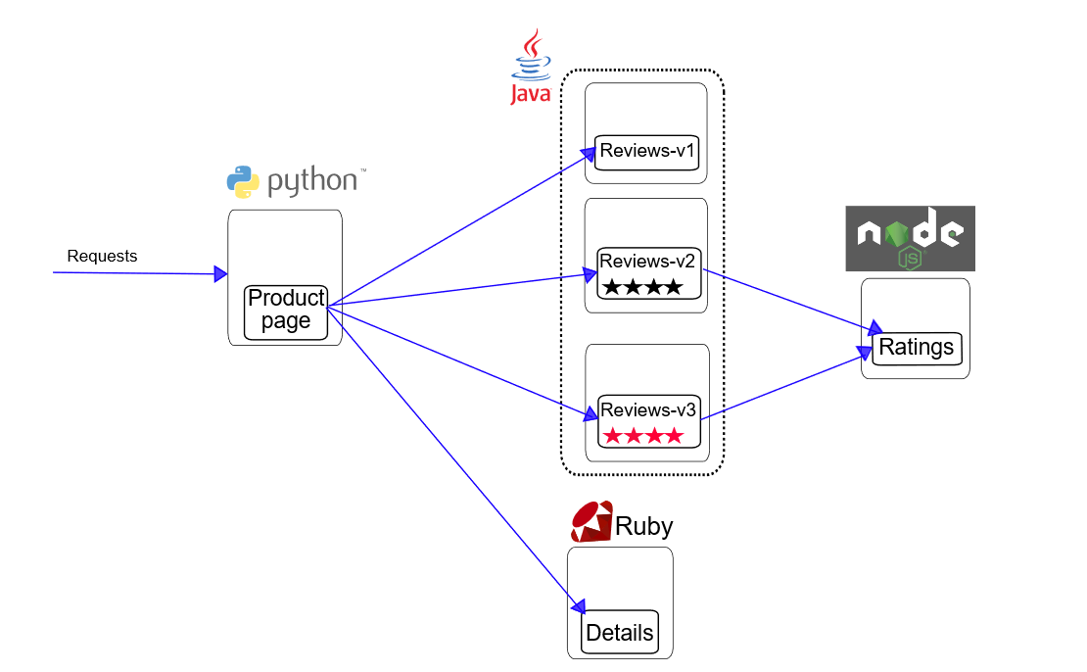
BookInfo Application
How it works:
1
Product Page
2
Reviews
V1
V2
V2
3
Details
4
Ratings

